Slide 1


Computer Science: An Overview
Twelfth Edition
Chapter 2
Data Manipulation（操控）
Yu Yang
School of Computer Science,
Pingdingshan University,
yangyu@pdsu.edu.cn
Notes:
If this PowerPoint presentation contains mathematical equations, you may need to check that your computer has the following installed:
1) MathType Plugin
2) Math Player (free versions available)
3) NVDA Reader (free versions available)

Slide 2
Learning Objectives
2.1 Computer Architecture（体系结构）
2.2 Machine Language
2.3 Program Execution（程序执行）
2.4 Arithmetic/Logic Instructions（算术/逻辑指令）
2.5 Communicating with Other Devices
2.6 Program Data Manipulation（数据操控编程）
2.7 Other Architectures（体系结构）

Slide 3
Computer Architecture（计算机体系结构）
Central Processing Unit (C P U) or processor
Arithmetic/Logic unit versus Control unit
Registers
General purpose（通用寄存器）
Special purpose（专用寄存器）
Bus（总线）
Motherboard（主板）

Slide 4
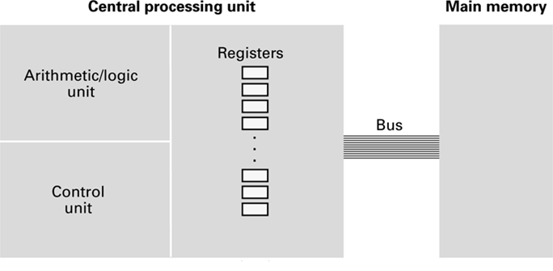
Figure 2.1 C P U and Main Memory（存储器） Connected via a Bus（总线）

Slide 5
Stored Program Concept（存储程序概念）
A program can be encoded（编码） as bit patterns（位模式） and stored in main memory. From there, the C P U can then extract（提取） the instructions（指令） and execute them. In turn, the program to be executed can be altered （改变）easily.
之前是程序设置到CPU里面，导致只见树木不见森林

Slide 6
Terminology
Machine instruction: An instruction (or command) encoded（编码） as a bit pattern recognizable（可被识别） by the C P U
Machine language: The set of all instructions recognized by a machine

Slide 7
Machine Language Philosophies（哲学）
Reduced Instruction Set Computing (R I S C)（精简指令集计算机）
Few, simple, efficient, and fast instructions
Examples: PowerP C（处理器） from Apple/I B M/Motorola and A R M
Complex Instruction Set Computing (C I S C)
Many, convenient, and powerful instructions
Example: Intel（处理器）
Advanced RISC Machine (ARM) 设计了款低耗电RISC,高通和德州仪器等供应商制造的基于ARM的处理器

Slide 8
Machine Instruction Types（类型）
Data Transfer: copy data from one location to another
Arithmetic/Logic: use existing bit patterns to compute a new bit patterns
Control: direct（指挥） the execution of the program

Slide 9
Figure 2.2 Adding Values Stored in Memory（主存储器中的值相加）
Step 1. Get one of the values to be added from memory and place it in a register.
Step 2. Get the other value to be added from memory and place it in another register.
Step 3. Activate（激活） the addition circuitry（电路） with the registers used in Steps 1 and 2 as inputs and another register designated（ dezɪɡneɪtɪd ） to hold（存放） the result.
Step 4. Store the result in memory.
Step 5. Stop.

Slide 10
Figure 2.3 Dividing Values Stored in Memory（存储器中数值的除法运算）
Step 1. LOAD a register with a value from memory.
Step 2. LOAD another register with another value from memory.
Step 3. If this second value is zero, JUMP to Step 6.
Step 4. Divide the contents of the first register by the second register and leave the result in a third register.
Step 5. STORE the contents of the third register in memory.
Step 6. STOP.

Slide 11
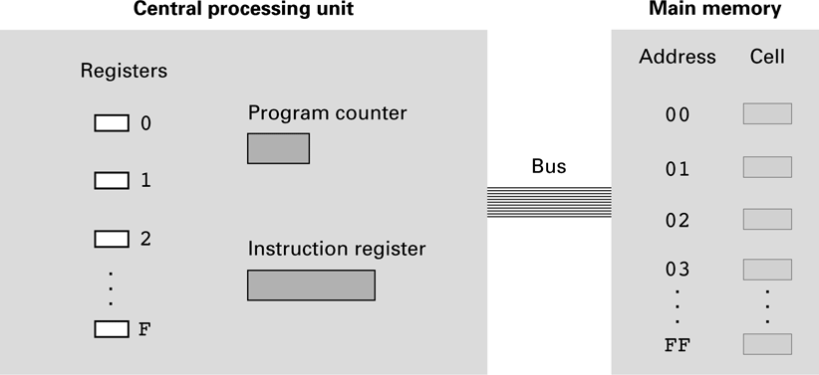
Figure 2.4 The Architecture of the Machine Described in Appendix C

Slide 12
Parts of a Machine Instruction（机器指令编码的部分）
Op-code: Specifies（指明） which operation to execute
Operand（操作数）: Gives more detailed information about the operation
Interpretation（解释） of operand varies（变动） depending on op-code

Slide 13
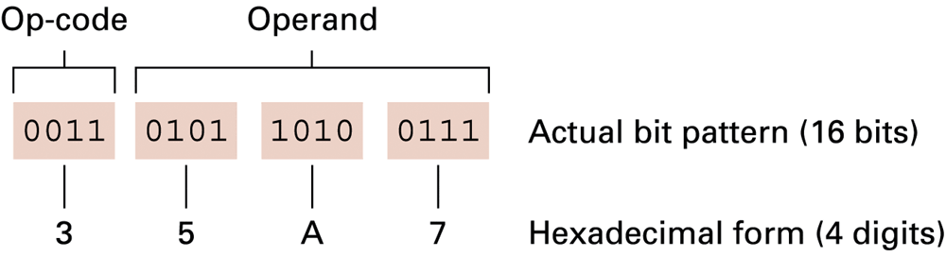
Figure 2.5 The Composition（组成） of an Instruction for the Machine in Appendix C

Slide 14
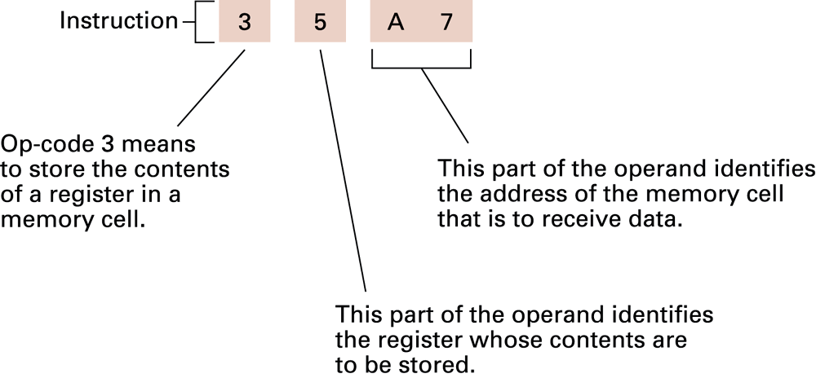
Figure 2.6 Decoding（译码） the Instruction 35A7

Slide 15
Figure 2.7 An Encoded Version（编码版本） of the Instructions in Figure 2.2
Encoded instructions | Translation
156C | Load（载入） register 5 with the bit pattern found in the memory cell at address 6C.
166D | Load register 6 with the bit pattern found in the memory cell at address 6D.
5056 | Add the contents of register 5 and 6 as though they were two’s complement（二进制补码） representation and leave the result in register 0.（结果存入寄存器0）
306E | Store the contents of register 0 in the memory cell at address 6E.
C000 | Halt.（停止）

Slide 16
Program Execution
Controlled by two special-purpose（专用） registers
Program counter: address of next instruction（下一个待执行的指令的地址）
Instruction register: current instruction（当前指令）
Machine Cycle
Fetch（取指令）
Decode（译码）
Execute（执行）

Slide 17
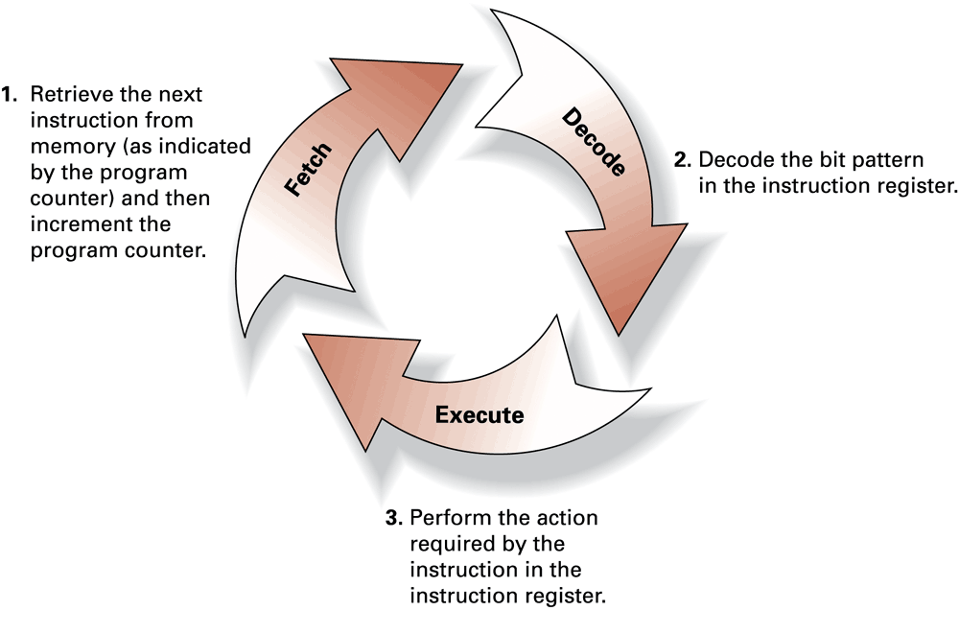
Figure 2.8 The Machine Cycle（机器周期）

Slide 18
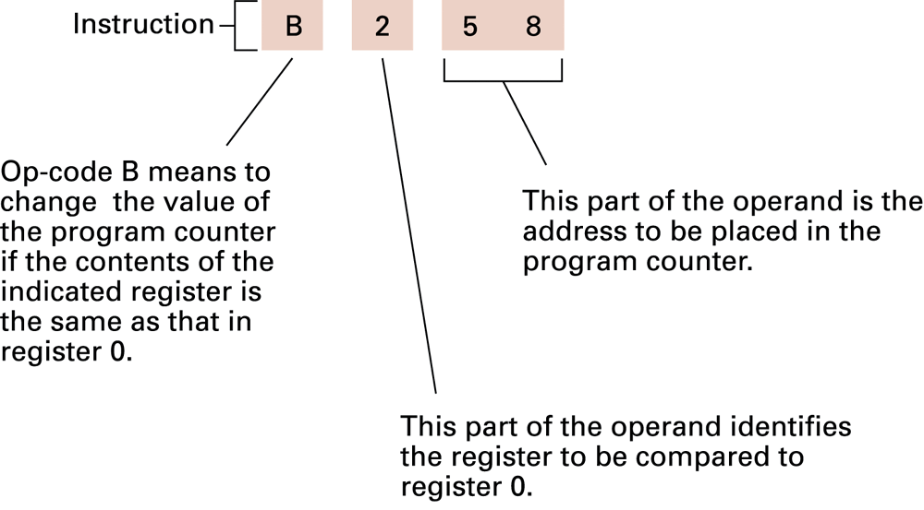
Figure 2.9 Decoding（译码） the Instruction B258

Slide 19
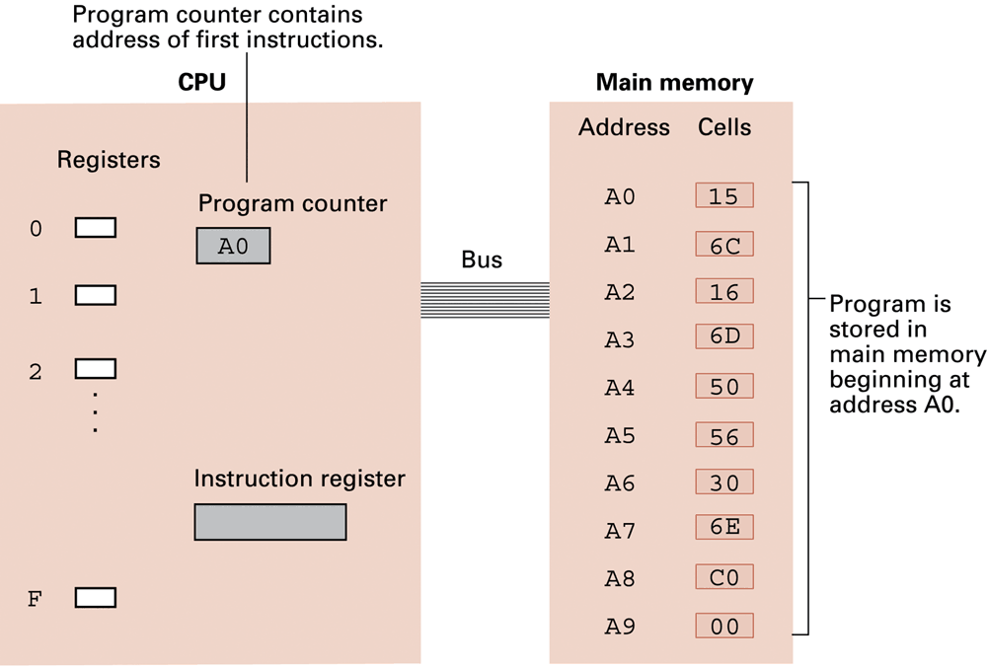
Figure 2.10 The Program from Figure 2.7 Stored in Main Memory（被存储在主存储器中） Ready for Execution（准备执行）

Slide 20
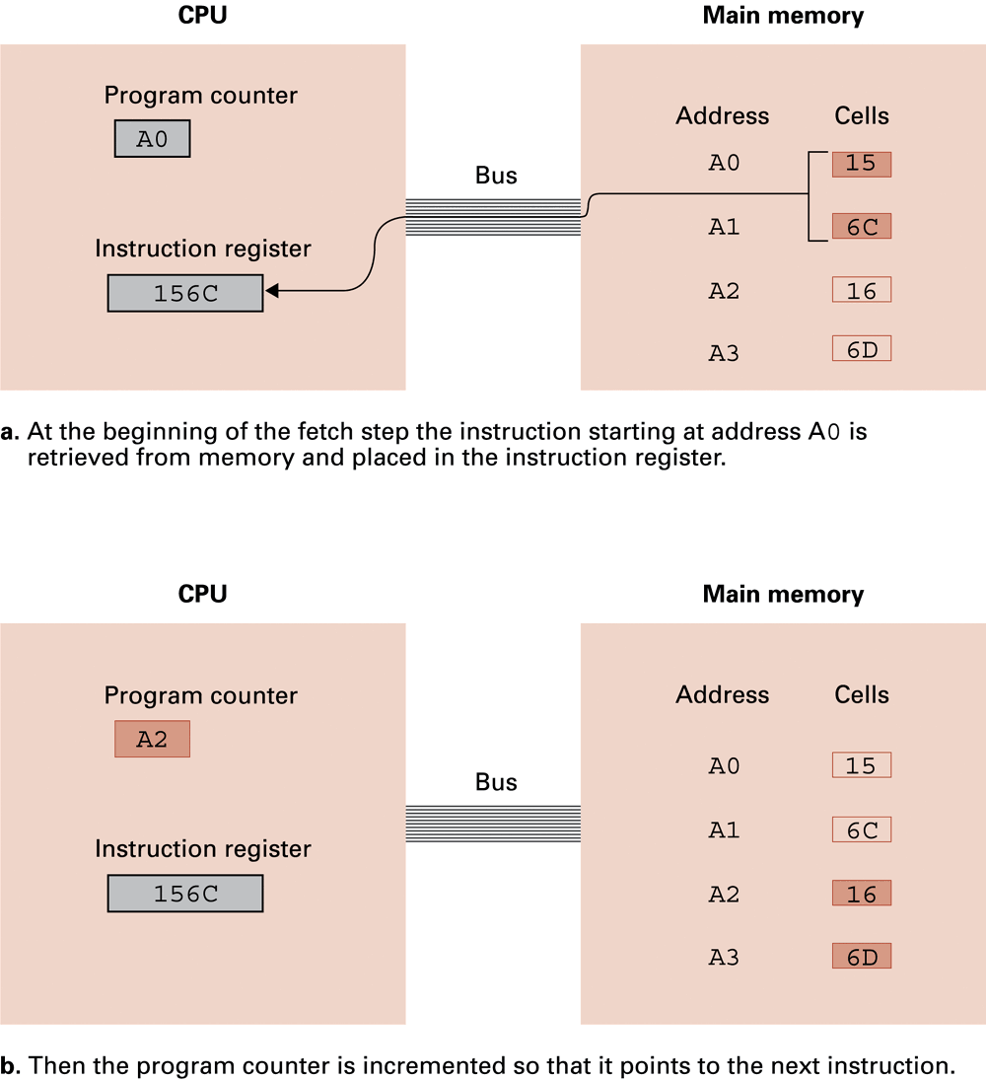
Figure 2.11 Performing the Fetch Step of the Machine Cycle (1 of 2)

Slide 21
Figure 2.11 Performing the Fetch Step of the Machine Cycle (2 of 2)

Slide 22
Arithmetic/Logic(算术逻辑) Operations
Logic: AND, OR, X OR
Masking（掩码屏蔽）
Rotate（轮循） and Shift: circular（循环移位） shift, logical shift, arithmetic shift
Arithmetic: add, subtract, multiply, divide
Precise action（精确的操作） depends on how the values are encoded (如何编码two’s complement versus floating-point).

Slide 23
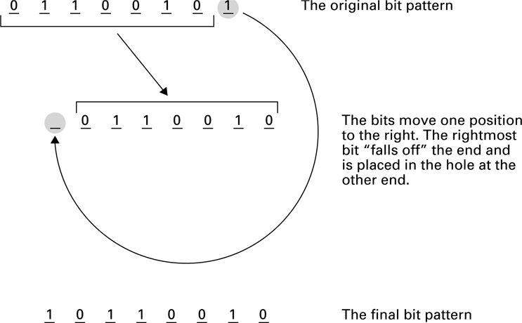
Figure 2.12 Rotating（循环右移） the Bit Pattern 65 (Hexadecimal) One Bit to the Right

Slide 24
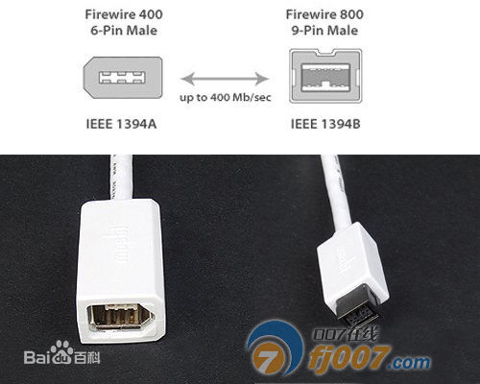
Communicating with Other Devices
Controller（控制器）: An intermediary apparatus（器械） that handles communication between the computer and a device
Specialized controllers for each type of device
General purpose controllers (U S B and FireWire)
Port: The point at which a device connects to a computer
Memory-mapped I/O: C P U communicates with peripheral（外围） devices as though
they were memory cells

Slide 25
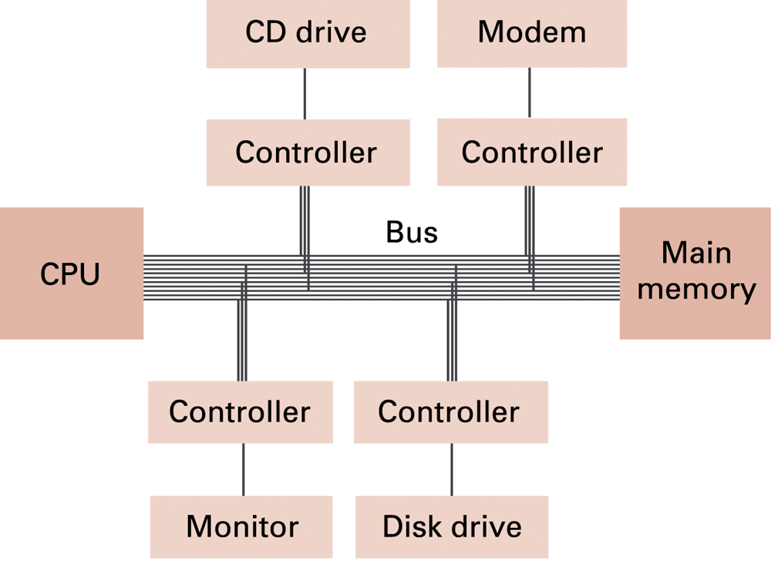
Figure 2.13 Controllers Attached（相连） to a Machine’s Bus

Slide 26
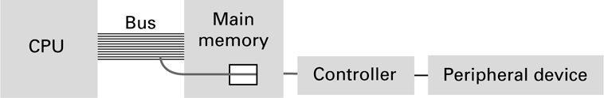
Figure 2.14 A Conceptual Representation（概念表示） of Memory-Mapped I/O

Slide 27
Communicating with Other Devices (1 of 2)
Direct memory access (D M A): Main memory access by a controller over the bus
Von Neumann Bottleneck: Insufficient bus speed impedes performance
Handshaking: The process of coordinating the transfer of data between components

Slide 28
Communicating with Other Devices (2 of 2)
Parallel Communication: Several communication paths transfer bits simultaneously.
Serial Communication: Bits are transferred one after the other over a single communication path.

Slide 29
Data Communication Rates
Measurement units
B p s: Bits per second
K b p s: Kilo-bps (1,000 b p s)
M b p s: Mega-bps (1,000,000 b p s)
G b p s: Giga-bps (1,000,000,000 b p s)
Bandwidth: Maximum available rate

Slide 30
Programming Data Manipulation
Programing languages shields users from details of the machine:
A single Python statement might map to one, tens, or hundreds of machine instructions
Programmer does not need to know if the processor is R I S C or C I S C
Assigning variables surely involves LOAD, STORE, and MOVE op-codes

Slide 31
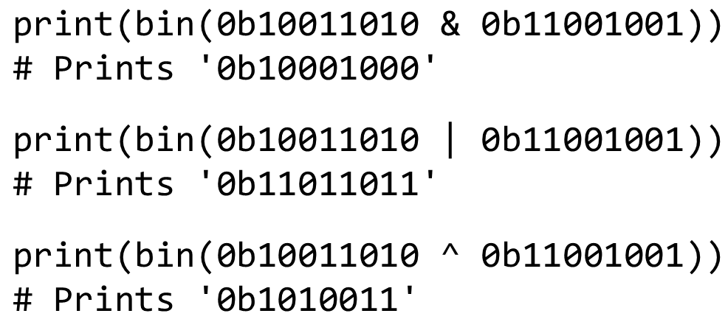
Bitwise Problems as Python Code

Slide 32
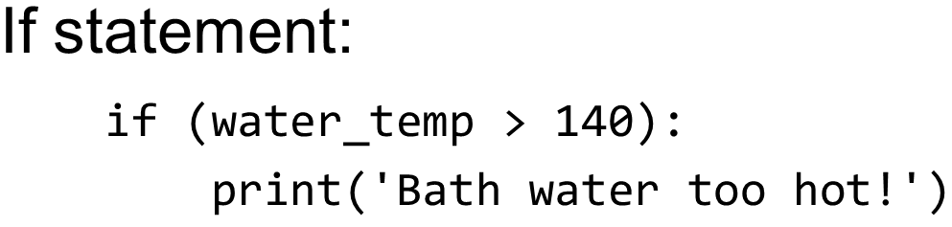
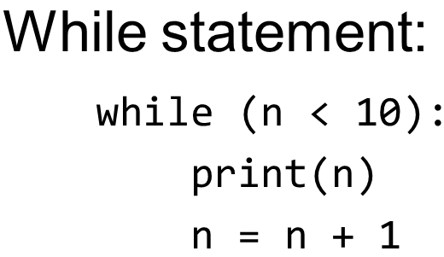
Control Structures

Slide 33
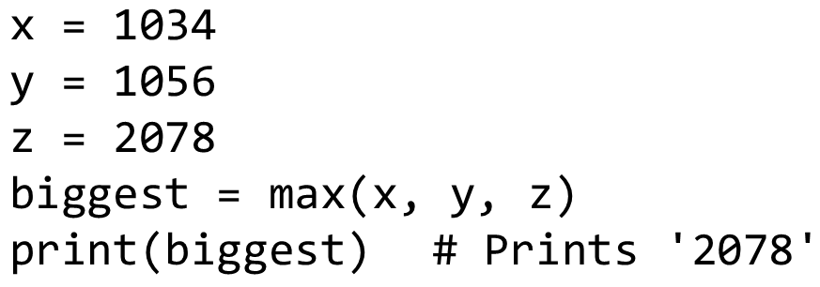
Functions (1 of 2)
Function: A name for a series of operations that should be performed on the given parameter or parameters
Function call: Appearance of a function in an expression or statement

Slide 34
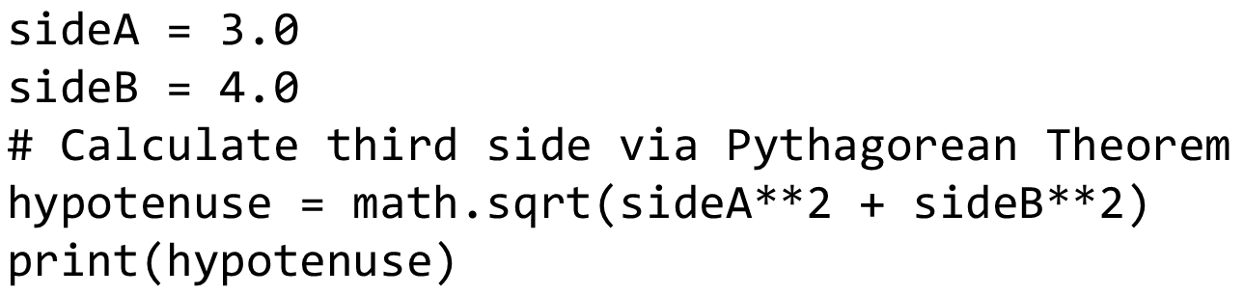
Functions (2 of 2)
Argument Value: A value plugged into a parameter
Fruitful functions return a value
void functions, or procedures, do not return a value

Slide 35
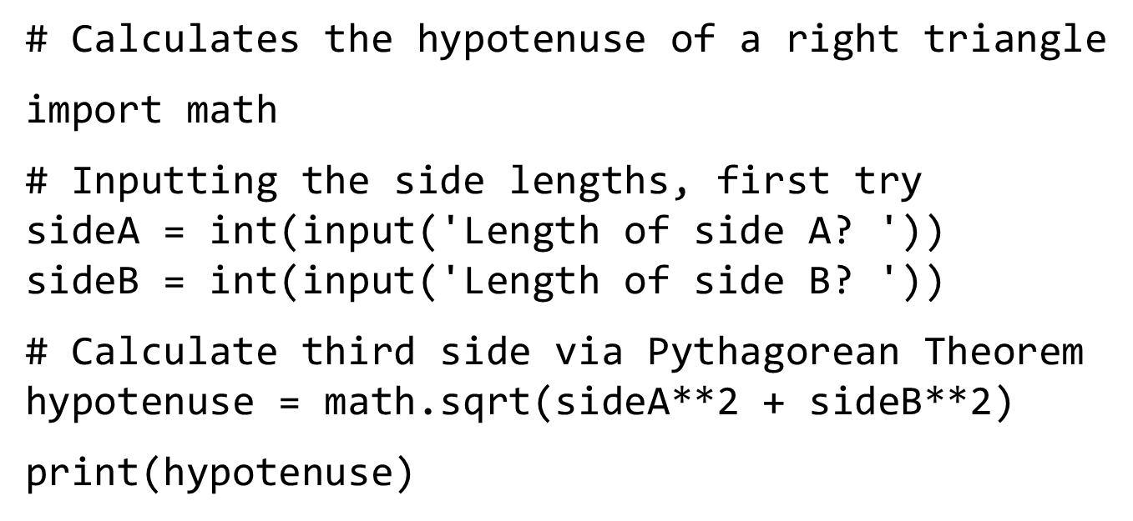
Input / Output

Slide 36
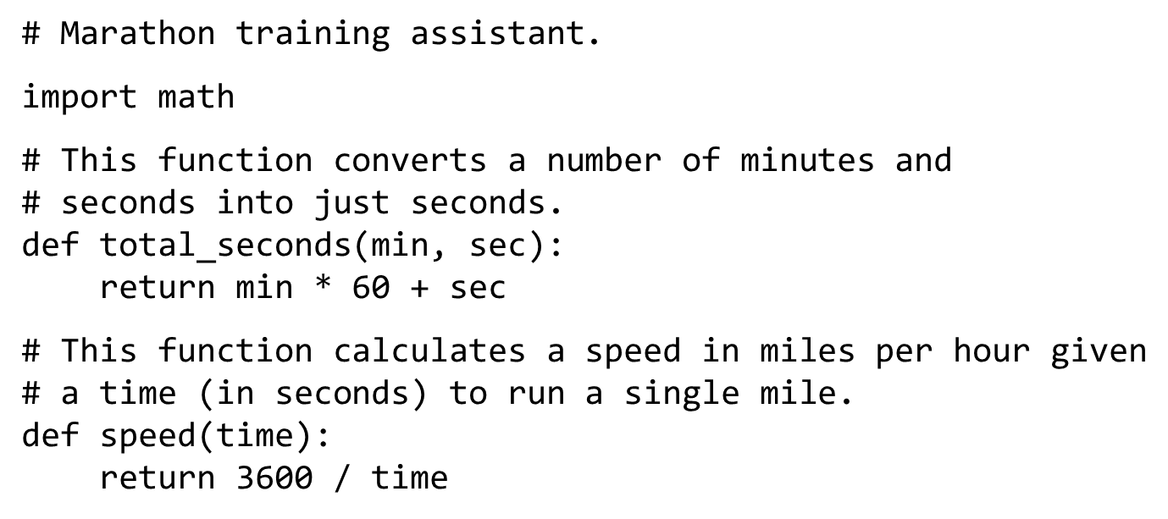
Marathon Training Assistant (1 of 2)

Slide 37
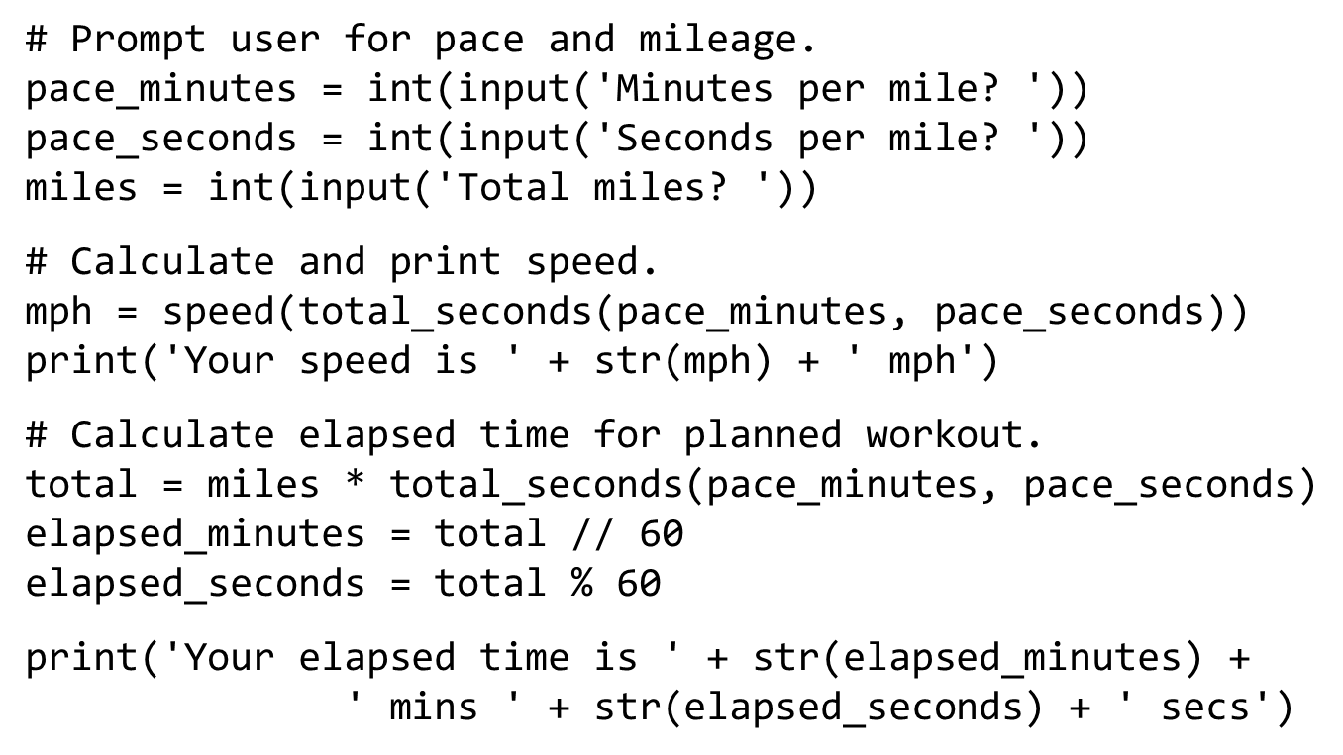
Marathon Training Assistant (2 of 2)

Slide 38
Figure 2.15 Example Marathon Training Data
Time Per Mile Minutes | Time Per Mile Seconds | Miles | Speed (m p h) | Total Elapsed Time Minutes | Total Elapsed Time Seconds
9 | 14 | 5 | 6.49819494584 | 46 | 10
8 | 0 | 3 | 7.5 | 24 | 0
7 | 45 | 6 | 7.74193548387 | 46 | 30
7 | 25 | 1 | 8.08988764044 | 7 | 25

Slide 39
Other Architectures
Technologies to increase throughput:
Pipelining: Overlap steps of the machine cycle
Parallel Processing: Use multiple processors simultaneously
S I S D: No parallel processing
M I M D: Different programs, different data
S I M D: Same program, different data

